Slide 1


AI-Powered Waste Sorting System
Integrating Deep Learning with Robust Database Management
Dhruv Kannojia
590011908
Dhruv.11908@stu.upes.ac.in

Slide 2






Project Overview
The Problem
The Solution
Analytics
Inefficient manual sorting leads to contamination and low recycling rates.
An automated hybrid system using CNNs for vision and SQL for intelligence.
Using DBMS to audit performance and optimize the sorting process.

Slide 3

Manual Sorting Challenges
Traditional waste management relies heavily on manual labor, which is slow, hazardous, and error-prone.
As waste volume increases globally, the inability to quickly and accurately separate recyclables from landfills results in massive environmental and economic loss.
High Contamination
Slow Processing Speed
Lack of Data Auditing

Slide 4

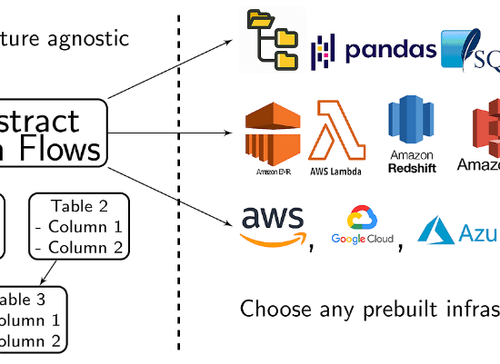
System Architecture
A Hybrid Pipeline
The system is designed as a unidirectional data pipeline with a feedback loop for analytics.
1. Input: Unsorted images from file system.
2. AI Core: CNN classifies the image.
3. DBMS: MySQL logs the result permanently.

Slide 5
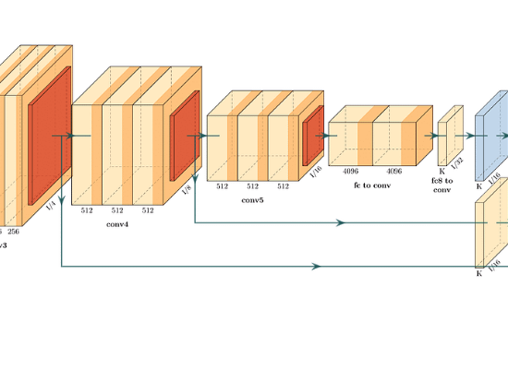
The AI Component: CNN
Deep Learning Model
We trained a Convolutional Neural Network (CNN) using TensorFlow and Keras.
Dataset Size 5,927 Images
Categories 10 Classes
Validation Accuracy ~88.7%
The model processes 128x128 pixel images and outputs a probability score for classification.

Slide 6

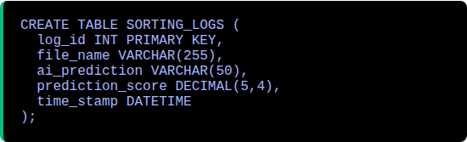
The Core: MySQL Database
Centralized Logging
The database is not just storage; it is the audit trail. Every single AI decision is captured in real-time.

Slide 7
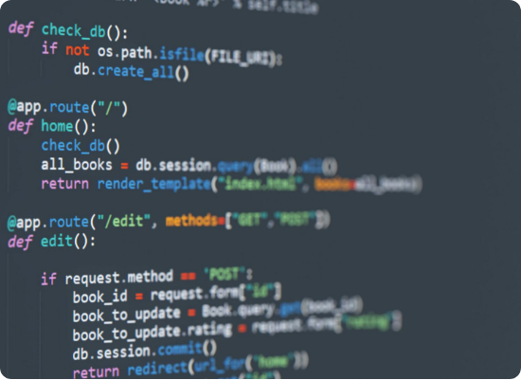
Integration: The "Glue" Code
Python Deployment Script
A single Python script (`deploy_sorter.py`) orchestrates the entire operation, connecting the File System, AI Model, and Database.
Load: Initializes the trained Keras model.
Predict: Generates category & confidence.
Move: Physically sorts the file using `shutil`.
Log: Executes SQL `INSERT` command.

Slide 8
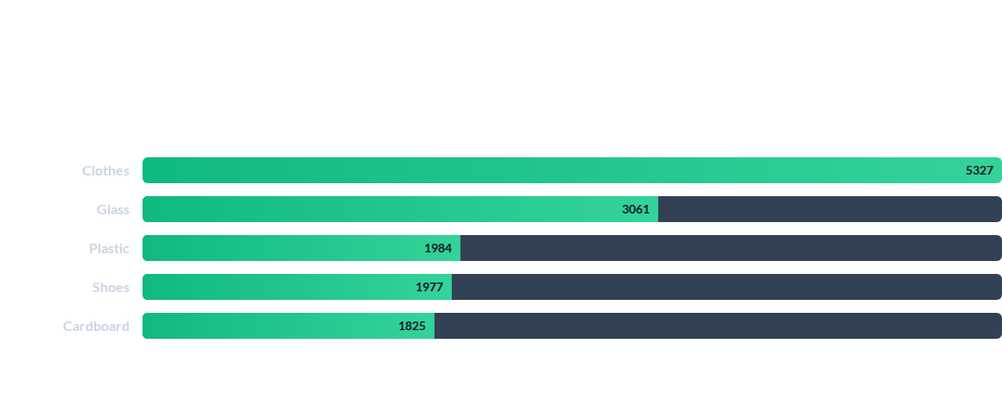
Result 1: Waste Frequency Analysis
Querying the database reveals the composition of the waste stream, allowing for optimized resource allocation.

Slide 9

Result 2: Model Confidence Audit
The DBMS allows us to filter for low-confidence predictions. These records are critical for identifying where the model needs re-training.
SQL Query: Low Confidence Warning
SELECT file_name, ai_prediction, prediction_score
FROM SORTING_LOGS
WHERE prediction_score < 0.80;
File Name | Prediction | Score | Action
img_042.jpg | Plastic | 0.6540 | Manual Review
scan_99.jpg | Metal | 0.7812 | Flagged

Slide 10



Conclusion
Success
Integration
Value
Successfully automated the classification of 120 test images with high accuracy.
Demonstrated seamless data flow between Python ML logic and MySQL storage.
Proved that DBMS is essential for auditing AI performance and operational transparency.
The system is scalable, auditable, and ready for future deployment.

Slide 11

Thank you for your attention.
Dhruv Kannojia
590011908 • Dhruv.11908@stu.upes.ac.in

